Slide 1
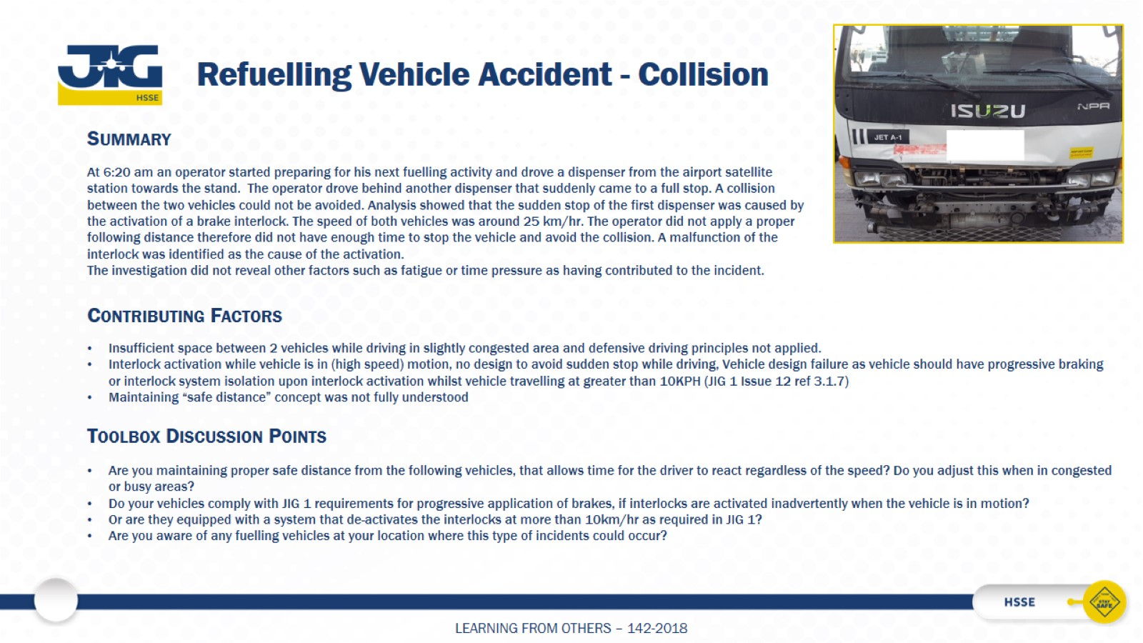
Refuelling Vehicle Accident - Collision

