Slide 1
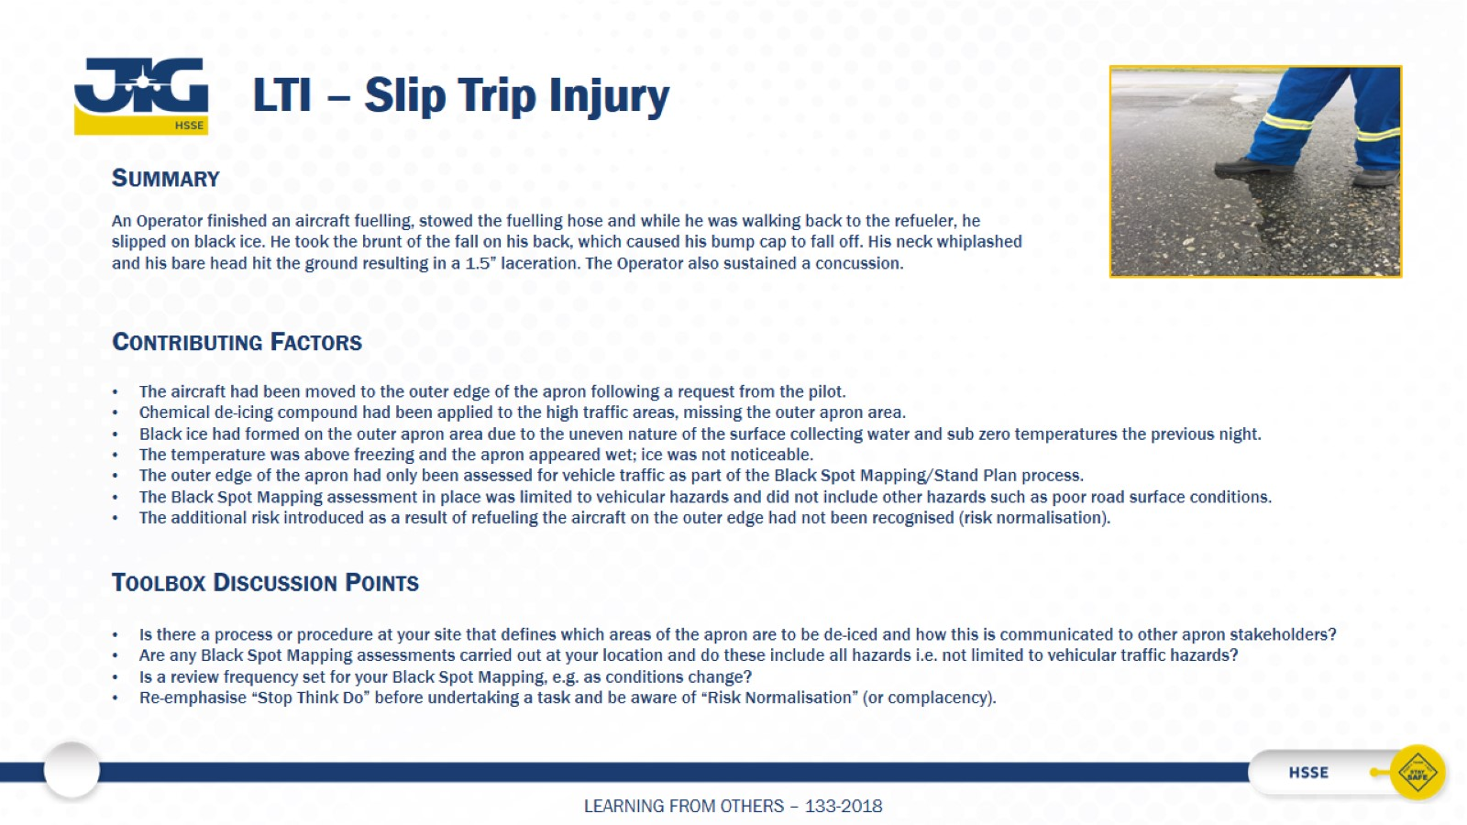
LTI – Slip Trip Injury

